Slide 1
Sponsored by
End-User Education Day | Webinar Series

Slide 2
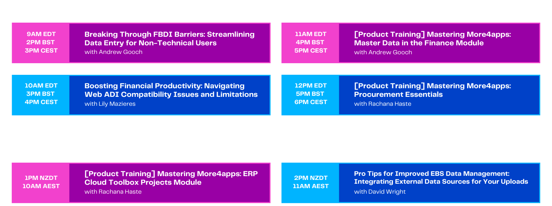
Sponsored by
End-User Education Day | Webinar Series

Slide 3
Boosting Financial Productivity: Navigating Web ADI Compatibility Issues and Limitations
Lily Mazieres
More4apps
Presales Product Specialist
UK & Europe
Lily.mazieres@more4apps.com
Notes:
Hi everyone and welcome to our More4apps presentation looking at webadi compatibility issues and limitations
I’m Lily Mazieres
I’ll start with a bit of background on me
I’ve been with More4apps for about 6 years now. I am one the product specialists here, so my role is essentially to chat with people about their data entry pain points and see if More4apps could be a good fit for them.
Prior to that, I have been in consulting for almost 10 years implementing and maintaining Oracle application for many different organizations.

Slide 4
Agenda
WebADI compatibility issues
WebADI limitations
Demo of GL Wizard
Your questions
Notes:
Here’s what we’ll be covering today.
We’ll look at the most common WebADI compatibility issues and limitations
Then we will see how it compares to Morea4apps
I will do a quick demo of one of our products, GL wizard, which many people use as a replacement of webadi in this area
Finally we will keep some time for a Q&A at the end

Slide 5
What’s the biggest struggle with Web ADI in your organization?
Let’s dive into why.
Notes:
But before we start, I would like to get a better understanding of why you are attending our session. I guess most people in the audience are not 100% satisfied with webadi so we would like to understand why.
First question is what is your biggest struggle with Webadi at the moment? Feel free to pick more than one problem if you encounter a few.
Main Problem
1. We don’t use WebADI
2. We don’t have any problems with WebADI
3. The templates we need are missing
4. Usability is difficult/Functionality is missing
5. Oracle Patching is causing us problems
6. Microsoft or Windows upgrade broke WebADI
7. No download functionality

Slide 6
Which Oracle version do you run?
Notes:
Second question is: Which Oracl;e version do you run?
11i
12.1
12.2
None of this:
I don’t know

Slide 7
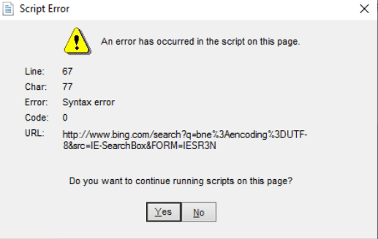
Web ADI challenges
It is not Upgrade-proof
Susceptible to Windows and Excel upgrades
Inclined to break when Oracle Patches and Upgrades applied
Not supported by Oracle in versions earlier than 12.2
In summary, it is not reliable!

Slide 8
Web ADI limitations
1. The Templates you need are just not there
2. The functionality is limited, confusing and difficult to operate.
Redundancies
Partial Validations
Lots of switching in and out of Oracle and the Spreadsheet to accomplish the task
Inconsistent look & feel between templates
No data-value defaulting
Rigid layouts

Slide 9
More4apps vs WebADI
Oracle forms
WebADI
Designed for end users
Completely supports mass data entry
Sheet data entry
User data entry forms
User customizable Layout
Realtime data validation
Form/sheet error feedback
Handles patches and upgrades with ease
Download existing data objects without limitations
Robust and stable
Free from development & internal support
Secure end-user connection to Oracle
Notes:
Now let’s see how it compares with More4apps
<CLICK>
There’s a lot to digest there, but the main points for this discussion today are at the bottom.
With WebADI, each time you do an upgrade or a patch, it just keeps breaking.
For many organizations we have discussed with, this was a real headache to maintain the solutions, especially the custom webadi templates and is typically costing companies a lot of time and money
So to think of WebADI as free is not quite accurate at times. There’s no up-front cost, but that’s not the full picture on the costing side.
Sometimes a little upfront cost can save you a lot of expense down the line.

Slide 10
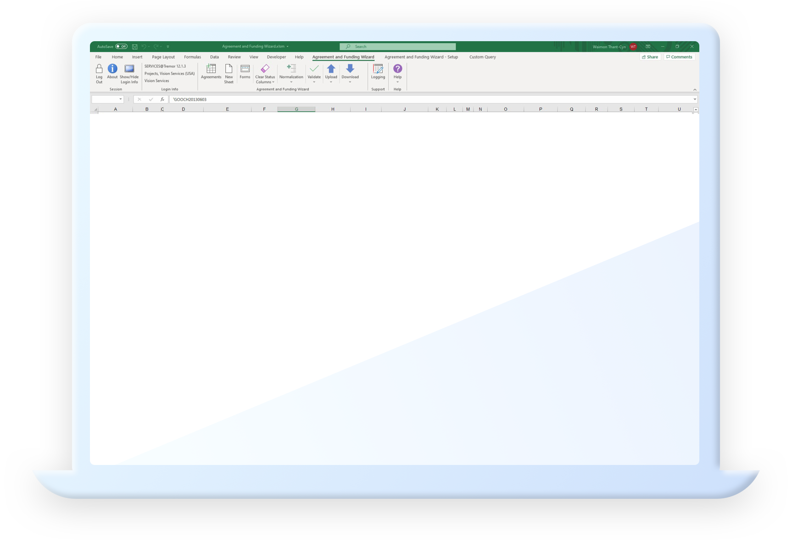
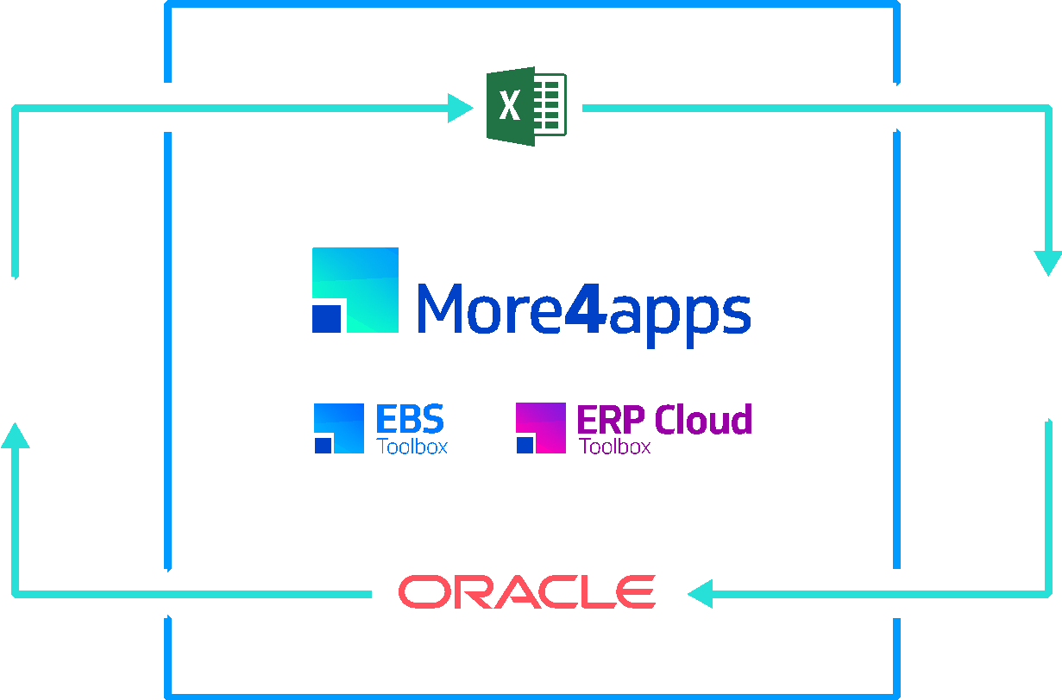
Spreadsheet loading tools that work for your business
Reliable Platform
Single Spreadsheet
Flexible Formatting
Advanced Validation
Download data from Oracle via secure connection
Upload data with real-time validation to Oracle
Notes:
And the More4apps solutions are aligned exactly to how you would intend to use WebADI but without all the negative aspects we’ve just been talking about
It’s a reliable platform as it’s support on all EBS and Excel versions, it provides a single interface, flexible formatting, so end users can tailor their own templates, and advanced validation
With More4apps you get a pre-configured reusable spreadsheet with built in upload and download

Slide 11
Asset Wizard
General Ledger Wizard
Employee Wizard
Element Entry Wizard
Special Information Wizard
Item Cost Wizard
Material Transaction Wizard
Bill of Materials Wizard
Item Wizard
Routing Wizard
AR Invoice API Wizard
AR Receipt Wizard
Customer Wizard
Pricing Modifiers Wizard
Price List Wizard
Sales Order Wizard
AP Invoice Wizard
Purchase Order Wizard
PO Receiving Wizard
Requisition Wizard
Supplier Wizard
Sourcing Wizard
Price List Wizard
Pricing Modifiers Wizard
Project Wizard
Budget Wizard
Project Transaction Wizard
Event Wizard
Agreement & Funding Wizard
System Administration Loader
Notes:
This is a breakdown of the main tools More4apps offers in each area of the application.
It’s not an exhaustive list but the main areas of support are covered there and you can see that compared to WebADI there is support for loading data across the whole ERP
. It’s not just niche tools that aid a particular task, but a comprehensive suite that covers master data, invoicing, ordering and transactional processing.
You select the tools you need, you don’t need to commit to anything more than you require, and you can upscale to other areas as and when the needs arise.

Slide 12
Let’s Check Out the GL Wizard

Slide 13
Your Questions
Lily Mazieres
More4apps
Presales Product Specialist
UK & Europe
Lily.mazieres@more4apps.com

Slide 14
